Slide 1

Explorations in Baton Rouge Crime Incident Data
Photo by Vladimir Opriso on Unsplash

Slide 2


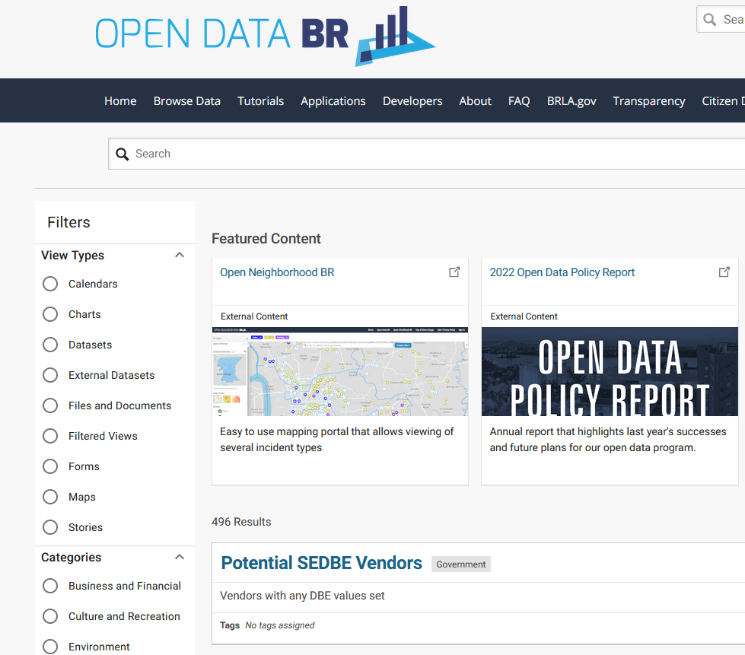
Open Data BR
Baton Rouge City-Parish government public data sets
East Baton Rouge Parish Combined Crime Incidents
Combination of crime incident reports from the East Baton Rouge Parish Sheriff's Office and the Baton Rouge Police Department, beginning January 1, 2021. Includes records for all crimes such as burglaries (vehicle, residential and non-residential), robberies (individual and business), auto theft, homicides and other crimes against people, property and society.
Notes:
I like this data set because
It’s real
It’s current
It’s important
It has personal meaning for me

Slide 3
Crime Incidents Data
Date & time
Geographic information
Address (some exceptions: sexual assault, domestic violence, human trafficking, and juveniles)
Police district, zone, and subzone
Neighborhood, Council district, crime prevention district
Latitude & longitude
Crime description
Crime against (Person, Property, or Society)
Statute category, title, and description
NIBRS* code and description
~277,000 rows
Each row represents a single charge.
A crime incident can have multiple charges.
*National Incident-Based Reporting System

Slide 4


NIBRS
National Incident-Based Reporting System
National, centralized crime reporting system coordinated and maintained by FBI. Used by law enforcement agencies in the United States for collecting and reporting data on crimes.
86 NIBRS codes, each identifying a particular class of crime, each belonging to one of two groups, A or B.
Group A: Detailed facts about these offenses gathered & reported to NIBRS.
Group B: Only arrest information reported.

Slide 5
Data Cleaning

Slide 6
Data cleaning
Removed crimes committed before Jan. 1, 2021 (out of scope) or after Oct. 31, 2024.
Removed 507 duplicate rows
Replaced NIBRS code ′0′ with NaN
Converted strings from ALL CAPS to lowercase or title case
Standardized inconsistently formatted statute titles (e.g.,′14:6.2′ and ′14:6.2′)
Standardized statute categories (many statutes assigned to multiple categories)
Notes:
All these bullet points fit on one slide but this took a lot of time

Slide 7
Visualizations

Slide 8
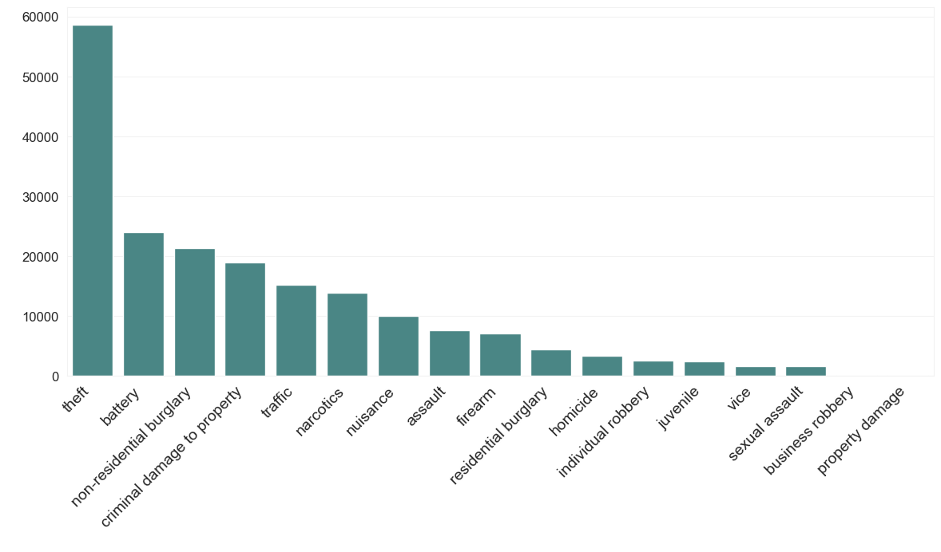
Charges by statute category

Slide 9
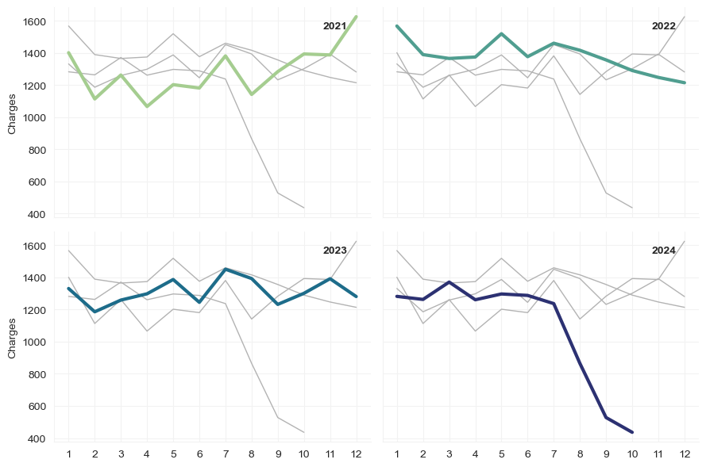
Visualizing a category by year
Theft seems to have had a pronounced downturn since July

Slide 10
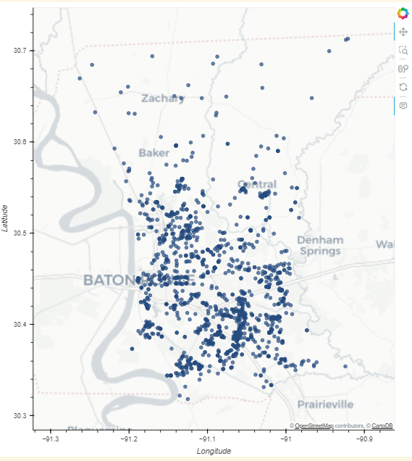
Mapping incident locations
Theft incidents in the past 3 months (August, September, October)
Filtered for only crimes in East Baton Rouge Parish
Notes:
I also wrote a function to plot maps.
These are made with HoloViews, so they’re interactive in the notebook.

Slide 11
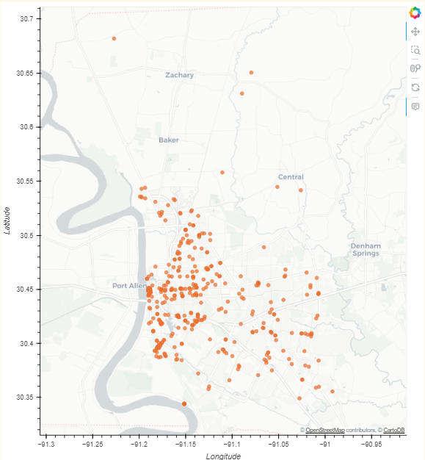

A map of drunkenness
Offense or statute description includes ‘drunk’

Slide 12
Working with NIBRS data

Slide 13
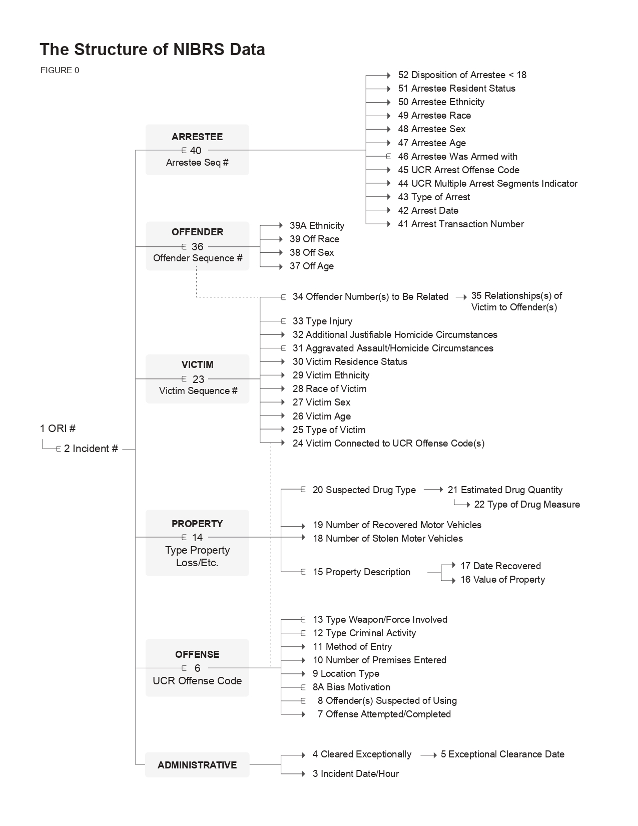

Public NIBRS data
FBI makes some NIBRS data available to the public
Download includes script for creating PostgreSQL database.
It still took me the better part of a whole day to install Postgres & get the script running without errors

Slide 14
NIBRS Data
The incident records in the NIBRS data and the records in the Baton Rouge data don’t have the same keys!
An NIBRS incident key: 150967597
A Baton Rouge incident number: 24-212338
An NIBRS offense id: 180930640
A Baton Rouge charge id: 3782AC50-7369-4CF2-A0B1-26C4D0626153

Slide 15
Can still work with NIBRS incident codes
Each NIBRS code has
a description
a category
a ‘crime against’ classification
‘A’ or ‘B’ group assignment

Slide 16
Group A Offenses
Detailed information is collected about these offenses
Animal Cruelty
Arson
Assault (Aggravated, Simple, Intimidation)
Bribery
Burglary/Breaking and Entering
Counterfeiting/Forgery
Destruction/Damage/Vandalism of Property
Drug/Narcotic Offenses (including drug equipment violations)
Embezzlement
Extortion/Blackmail
Fraud (false pretenses/swindle/confidence game, credit card and ATM fraud, impersonation, welfare and wire fraud)
Gambling (betting, wagering, operating/promoting/assisting gambling, gambling equipment violations, sports tampering)
Homicide (murder and non-negligent manslaughter, negligent manslaughter, justifiable homicide)
Human Trafficking
Kidnapping/Abduction
Larceny (pocket picking, purse snatching, shoplifting, theft and all other larceny)
Motor vehicle theft
Pornography/Obscene Material
Prostitution Offenses (prostitution, assisting or promoting prostitution)
Robbery
Sex Offenses, Forcible (forcible rape, forcible sodomy, sexual assault with an object, forcible fondling)
Sex Offenses, Non-forcible (incest, statutory rape)
Stolen Property Offenses/Fence
Weapon Law Violations

Slide 17
Group B Offenses
Only arrest information is reported for these incidents.
Bad Checks
Curfew/Loitering/Vagrancy Violations
Disorderly Conduct
Driving Under the Influence
Drunkenness
Family Offenses, Nonviolent
Liquor Law Violations
Peeping Tom
Trespass of Real Property
All Other Offenses

Slide 18
Over 30% of Baton Rouge data does not have an NIBRS code.
Can I use other data from other columns to predict what the code would be?
Could some combination of the green columns predict the NIBRS group or code

Slide 19
Prediction targets
NIBRS group (‘A’ or ‘B’) should be easy
There are 85 specific incident codes, so that might be harder.

Slide 20
Feature sets
Four columns:
Three combinations
Combination 1: All of the columns
Combination 2: The ‘language’ columns only (exclude statute title)
Combination 3: Statute title only

Slide 21
Supervised classification models
Trained & tested on data that does have NIBRS information
NIBRS group (the “easy” target) is binary (A/B) – can use any classifier.
Support Vector Classifier
Logistic Regression
NIBRS code (the “hard” target) needs a model adaptable to multiclass prediction.
Random Forest
Ran all models with K-Fold cross-validation.
Reported scores are average of fold scores.

Slide 22


Data preprocessing
Merge in NIBRS offense type information from PostgreSQL database
To get group labels
Text data
Tokenize
Convert to word count vector
Tokenizing took ~45 minutes
Notes:
Tokenization & word counts
Hard – I kept messing them up
Tokenization took forever (45 minutes)

Slide 23
Predicting NIBRS group
As expected, predicting the ‘A’ or ‘B’ group was very successful.
Training
Testing
All columns
99.99%
99.99%
Logistic Regression
Descriptions only
99.99%
99.99%
A/B group
Title only
98.56%
98.51%
All columns
100.00%
99.99%
SVC
Descriptions only
100.00%
100.00%
Title only
98.56%
98.54%
Running 2 models x 3 sets of features took ~30 minutes

Slide 24
Predicting NIBRS group
Predicting the individual incident code (of 86) was also successful!
Training
Testing
All columns
99.98%
99.96%
Incident code
Random Forest
Descriptions only
99.98%
99.98%
Title only
77.85%
77.94%
Running 1 models x 3 sets of features only took ~5 minutes

Slide 25
Predicting NIBRS group
I was so surprised that I had to look at the predictions just to see for myself.
Interestingly, I also ran a Random Forest on the title column with label-encoding (1, 2, 3, …, 561)
The results were abysmal
10.3% training accuracy
9.9% test accuracy

Slide 26
Final thoughts
There is so much more that can be done with this dataset!

Slide 27
Investigation
What’s up with the large theft downturn this year?
Look for seasonality or autocorrelation within crime categories
Look for correlations between crime categories
Investigate outliers
There’s an incident in the data set with 51 different charges!
Look at crime prevention districts: Is there a statistically significant difference between crime levels in these districts?

Slide 28
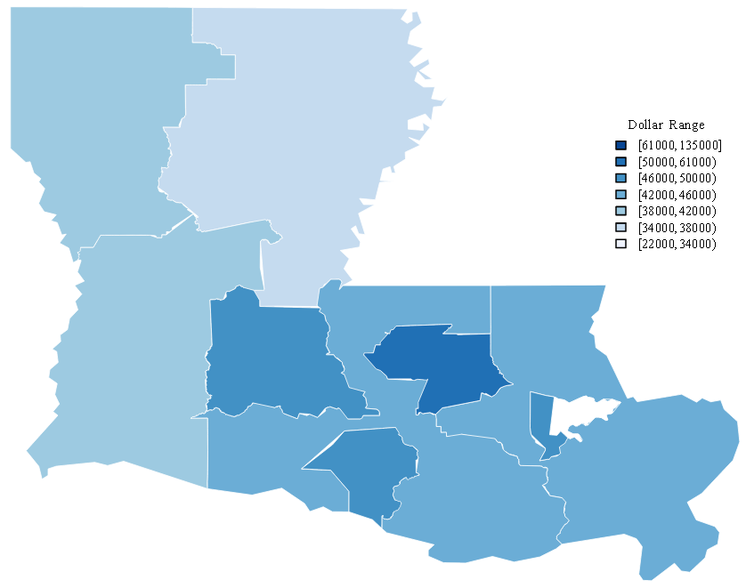
Geographic/Visualizations
Use a clustering algorithm to look for “hot spots”
Make a choropleth map
A choropleth map of the state of Louisiana

Slide 29
Questions?

